Slide 1

Effectiveness of promotional activities at Bharti Airtel
Submitted by – Saksham Sood
Reg no. - 11811869
Project Supervisor – Mr. Jatinder Shinghare

Slide 2

Bharti Airtel Limited
Bharti Airtel Limited is a leading global telecommunications company with operations in 18 countries across Asia and Africa. Headquartered in New Delhi, India, the company ranks amongst the top 3 mobile service providers globally in terms of subscribers. In India, the company's product offerings include 2G, 3G and 4G wireless services, mobile commerce, fixed line services, high speed home broadband, DTH, enterprise services including national & international long distance services to carriers. In the rest of the geographies, it offers 2G, 3G, 4G wireless services and mobile commerce. Bharti Airtel had over 423 million customers across its operations at the end of March 2020. To know more please visit, www.airtel.com

Slide 3
Bharti Airtel Limited
Airtel was born free, a force unleashed into the market with a relentless and unwavering determination to succeed. A spirit charged with energy, creativity and a team driven “to seize the day” with an ambition to become the most admired telecom service provider globally. airtel, in just ten years of operations, rose to the pinnacle of achievement and continues to lead.
As India's leading telecommunications company, airtel brand has played the role of a major catalyst in India's reforms, contributing to its economic resurgence.
Today we touch people's lives with our Mobile services, Telemedia services, to connecting India's leading 1000+ corporates. We also connect Indians living in USA, UK and Canada with our call home service.

Slide 4
Airtel Business
Mission – Hunger to win customers for life.
Vision – Our vision is to enrich the lives of our customers. Our obsession is to win customers for life through an exceptional experience.

Slide 5
Our Values
Alive - We are alive to the needs of our customers. We act with passion, energy and a can-do attitude to help our customers realize their dreams. Innovation and an entrepreneurial spirit drive us - if it can’t be done, we’ll find a way.
Inclusive - Airtel is for everyone - we champion diversity, recognizing the breadth and depth of the communities we serve. We work with them, anticipating, adapting and delivering solutions that enrich their lives. We do this by having an open mind and embracing change.
Respectful - We live the same lives as our customers, sharing the same joys and the same pains. We never forget that they are why we exist. We act with due humility, always open and honest, to achieve mutual respect.

Slide 6
Bharti Airtel Limited
Established - July 07, 1995, as a Public Limited Company
Revenue - Rs. 875,390 million (Full Year ended March 31, 2020) Rs. 807,802 million (Full Year ended March 31, 2019)
EBITDA - Rs. 371,053 million (Full Year ended March 31, 2020) Rs. 262,937 million (Full Year ended March 31, 2019)
Listings - Bombay Stock Exchange Limited (BSE) National Stock Exchange of India Limited (NSE)
Customer base(India) - 283.7 million Mobile Services; 2.4 million Homes and 16.6 million Digital TV Services (status as on March 31, 2020)

Slide 7
Airtel Business
We as Account Managers are working under the business domain of Bharti Airtel also called as
Airtel Business.
Airtel Business offers innovative solutions with Global data, global Voice, superfast Internet connectivity across industries.

Slide 8
On job training
During our On Job Training, I joined the company as an Account Manager under business domain of Bharti Airtel also known as Airtel Business.
As an account manager, my job role is to approach customers and onboard them by providing them the best business solution according to their need and requirements.
Understanding customer’s requirements and providing them the best solution in their budget was always a challenge. But Kudos to our reporting managers and supervisors who were always there to help.
I used to do research about the market and the market condition. As well as I used to look for potential customer in different domains and to identify them, so that I can pitch our product to them.

Slide 9
Airtel Business Products
Mobile Services – Postpaid Mobile, Data Card, International Roaming.
IOT and Enterprise Mobility - M2M Solutions, Managed Mobility, Tracking Solutions, Digital Engagement Solutions, Vehicle Telematics, Asset Tracking.
Fixed Line – Broadband, PRI, Domestic Toll free.

Slide 10
Airtel Business Products
Data Connectivity – Internet, MPLS, International Private Line, Local Access, VSAT, Integrated Solution, SD-WAN, Internet Leased Line, Managed Wi-Fi.
Collaboration – Video Conferencing, Audio Conferencing, Unified Conferencing.
Cyber Security – Product & Solutions, Services, Bundles, Security partnership

Slide 11
competitors
BSNL
Jio
Voda – idea

Slide 12

BSNL
BSNL is a top competitor of Airtel.
BSNL is a Government company that was founded in 2000 in New Delhi, Delhi.
BSNL operates in the Telecommunication Services industry.
Compared to Airtel, BSNL has 55,000 more employees.

Slide 13
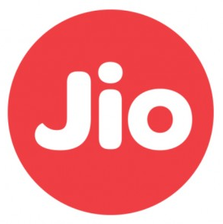
Reliance Jio Info COMM
Jio is seen as one of Airtel's biggest rivals.
Jio was founded in 2007, and is headquartered in Mumbai, Maharashtra.
Jio is in the Telecommunication Services industry.
Jio generates $9.7B less revenue vs. Airtel.

Slide 14

Vodafone
Vodafone is seen as one of Airtel's top competitors.
Vodafone was founded in Berkshire, England} in 1984.
Vodafone competes in the Telecommunication Services industry.
Compared to Airtel, Vodafone generates $38.1B more revenue.

Slide 15
Competitive Analysis
The top 10 competitors in Airtel's competitive set are BSNL, Jio, Vodafone, Tata Communications, Telefonica, MTN Group, Telenor, Netcom Broadband, Dish TV and Paytm.
Together they have raised over 25.7B between their estimated 376.7K employees. Airtel has 30,000 employees and is ranked 4th among it's top 10 competitors. The top 10 competitors average 38,401.

Slide 16
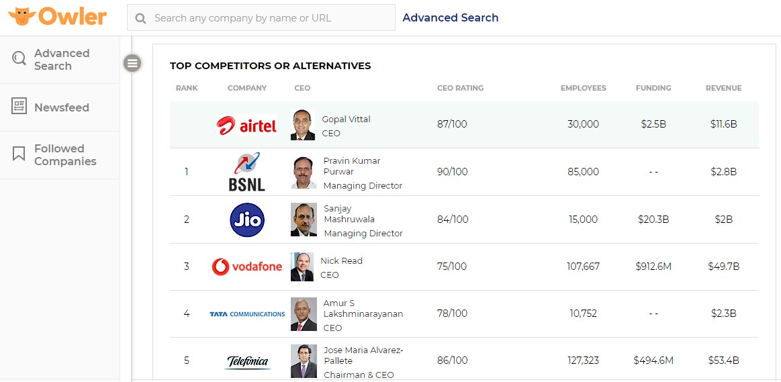
Competitive Analysis

Slide 17
learnings
I have learned the skills of interacting with the corporate people who have different expectations and demand.
I have been able to brush up even on my convincing skill as selling a product to someone requires a lot of convincing power which is very important at the end of the day .
I have learnt how to be positive as in sales a person will face rejection a lot of time and one should remain positive even after being rejected by the buyer of the product.
Understanding requirements has been a challenging task for me, as I was able to understand the market very well in terms of how products are going to be successful in market, what are the expectations of the user and the sensitive areas of the market.

Slide 18
Suggestions
Company should focus on the pricing as after the launch of Jio, every customer has became price consious.
Company should focus on the quality of service, as daily we receive a lot of complaints during our visits.

Slide 19

Thank you

